Slide 1



Team 8
Advanced Skin Disease Diagnosis

Slide 2
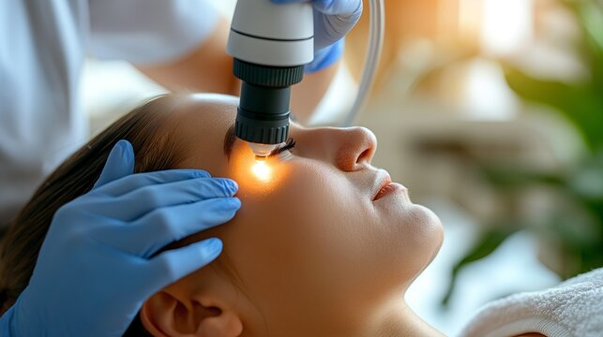



INTRODUCTION
Image-Based Diagnosis: The Advanced Skin Diagnosis System analyzes uploaded images of skin conditions to identify potential skin diseases.
Comprehensive Disease Detection: The system is capable of identifying a wide range of skin conditions, from common issues like acne to more complex dermatological diseases.
Specialization and areas of expertise , Instant Feedback: Users receive real-time results and recommendations based on the analysis, providing quick insights into potential skin concerns and facilitating early treatment.

Slide 3
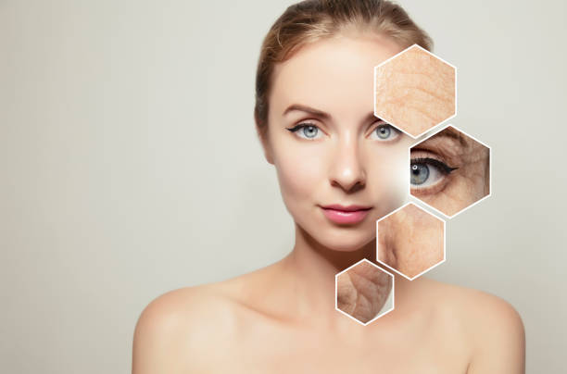
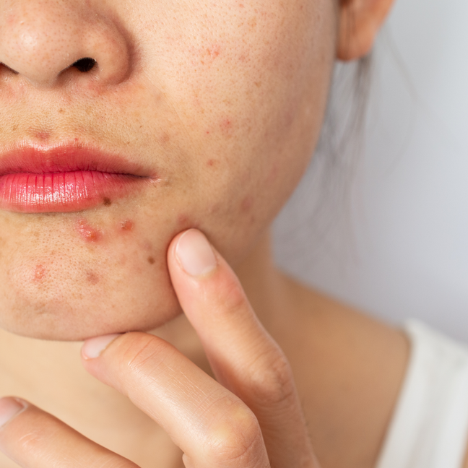
PROJECT OVERVIEW / CUSTOMER FEATURES
Create: Allows new users to register and set up their profile for accessing the skin diagnosis system.
Login: Provides secure access to the system for registered users to utilize diagnostic features.
Input Page: Enables users to upload an image of their skin condition for analysis.
View Page: Displays the diagnostic results and detailed information about the detected skin condition.

Slide 4

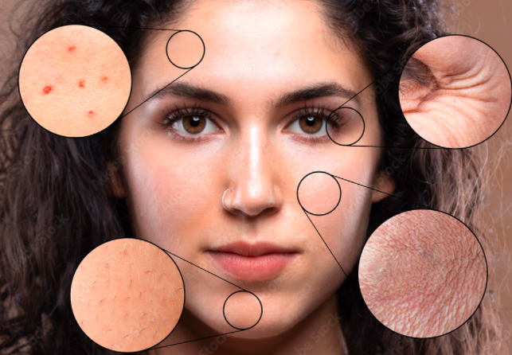

WORKING
User Image Input and UI Interaction: The project begins with a user-friendly interface (UI) that allows users to upload an image of a skin condition.
Image Processing and Feature Extraction with OpenCV: Once the image is uploaded, OpenCV is used to process the image. It performs various tasks such as noise reduction, image enhancement etc. which helps identify key areas of the skin disease. For instance, the dimensions of the affected area can be calculated, and significant patterns or features within the image are highlighted for further analysis.
Disease Detection and Result Display: After processing the image, a pre-trained Vision Transformer (ViT) model analyzes the image to accurately identify the skin disease by recognizing patterns and features. Once the disease is detected, the results are displayed back on the UI.
Complete Medical Equipment
Maternal & Child Health Center
Diagnostic & Radiology Center
Rehabilitation & Physiotherapy Center

Slide 5

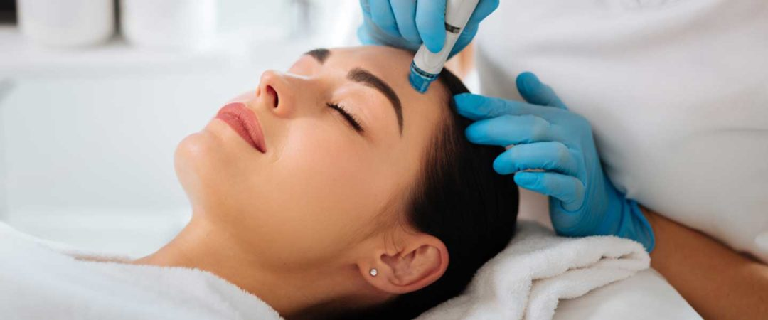
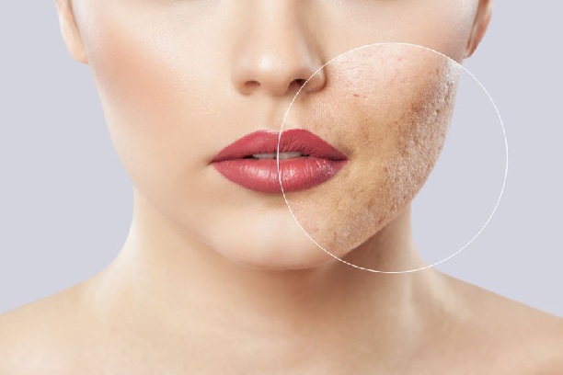

TECHNOLOGIES USED
Rapid Development Framework: Django is a high-level Python web framework that comes with built-in tools and features such as authentication, ORM (Object-Relational Mapping), and admin interfaces.
Security Features: Django has a strong focus on security. It includes features to protect against vulnerabilities like SQL injection, cross-site scripting (XSS), cross-site request forgery (CSRF)etc. Django also has built-in user authentication, session management, and password hashing.
Scalability and Flexibility: Django is highly scalable and suitable for large applications. It supports the separation of concerns with an MVC (Model-View-Controller) architecture. It's used by major companies like Instagram, Pinterest etc.

Slide 6

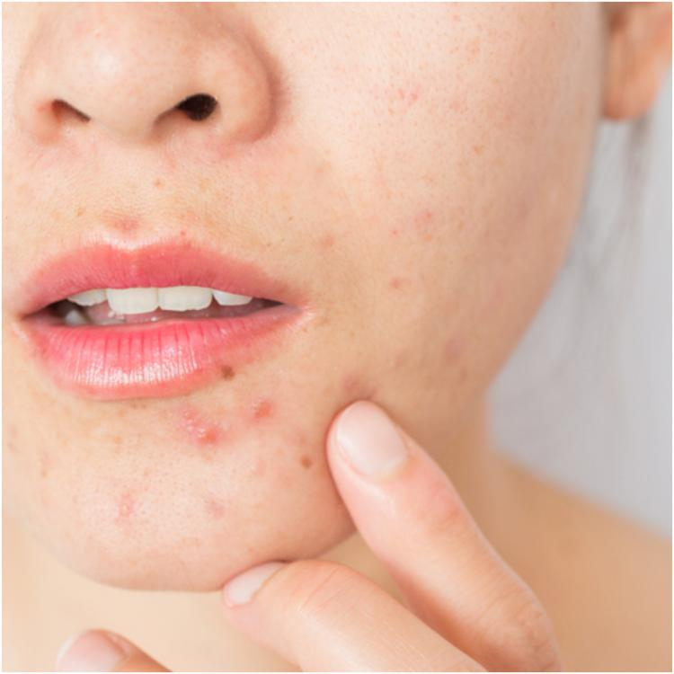
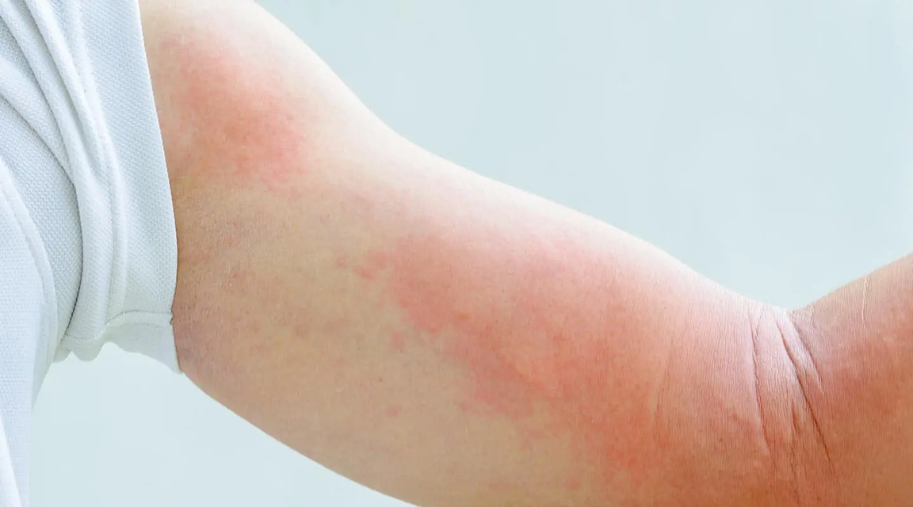
TECHNOLOGIES USED
OPENCV
Computer Vision and Image Processing Library: OpenCV (Open Source Computer Vision Library) is a highly efficient and popular open-source library designed for computer vision tasks such as image processing, object detection, face recognition, image manipulation, and machine learning.
Cross-Platform Support: OpenCV is cross-platform, meaning it works on various operating systems, including Windows, macOS, and Linux. It also supports different programming languages, including Python, C++, and Java, making it accessible to a wide range of developers and industries.
Wide Range of Features: OpenCV includes a broad set of functions for tasks like feature detection, motion tracking, camera calibration, 3D reconstruction, and machine learning. It can process images and videos, perform transformations, and even implement complex algorithms and deep learning-based image analysis.

Slide 7
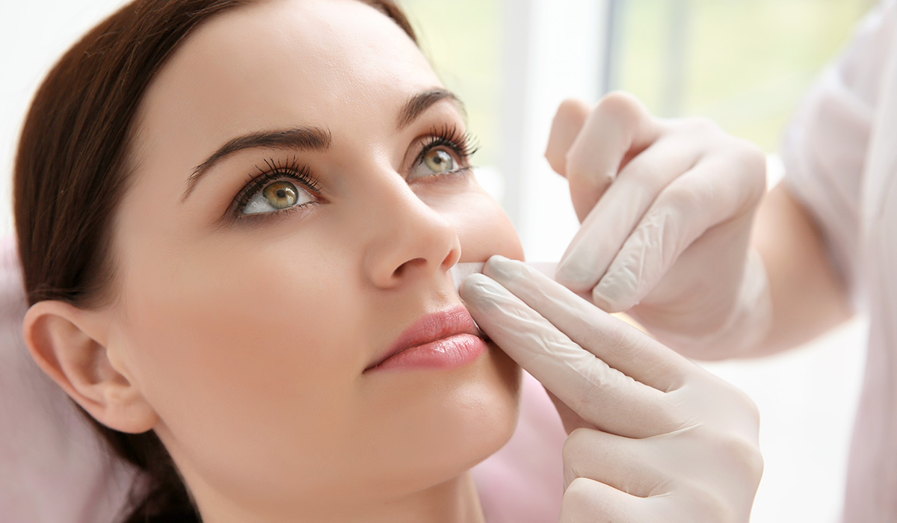
TECHNOLOGIES USED
VISION TRANSFORMER DEEP LEARNING MODEL
Transformers for Vision: Unlike traditional convolutional neural networks (CNNs), Vision Transformers treat an image as a sequence of patches, much like how transformers process text as a sequence of words. The image is divided into fixed-size patches (e.g., 16x16 pixels), and each patch is flattened and linearly embedded into a vector.
Self-Attention Mechanism: ViT uses the transformer’s self-attention mechanism to capture long-range dependencies in the image. This allows the model to learn contextual relationships between different parts of the image, which is useful for understanding complex visual patterns, especially in larger images.
Performance on Large Datasets: While CNNs tend to outperform transformers on smaller datasets, ViT excels when large-scale training data is available, as the transformer can leverage its attention mechanism to learn rich, global patterns from the data.

Slide 8
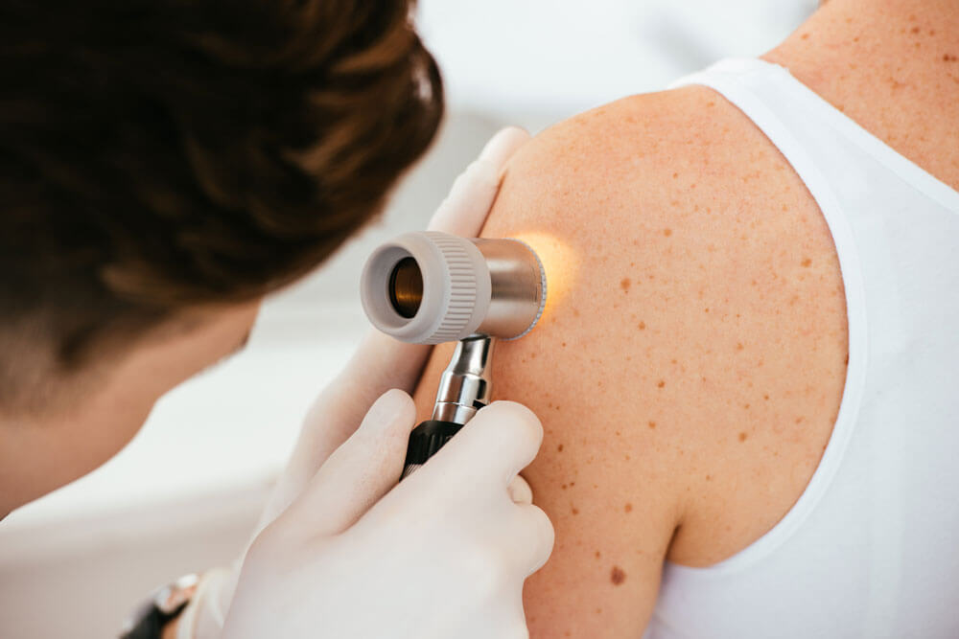
MILESTONE 1
User Authentication in Django: Implemented a user authentication system in Django, allowing users to securely register (sign-up), log in, and access their personal accounts. This involves using Django’s built-in authentication views and models to handle user credentials.
Personalized Home and Profile Pages: After logging in, authenticated users are directed to a personalized home page and profile page. These pages dynamically display user-specific information, which is fetched from the database using Django's ORM. This ensures that each user sees their own data upon accessing their account.
Security and Account Management: The authentication feature includes security measures like password hashing and secure login/logout functionality. Additionally, we have implemented features for profile management, allowing users to update their personal details, change passwords, or manage settings after logging in. This provides a secure and personalized experience for the users.

Slide 9
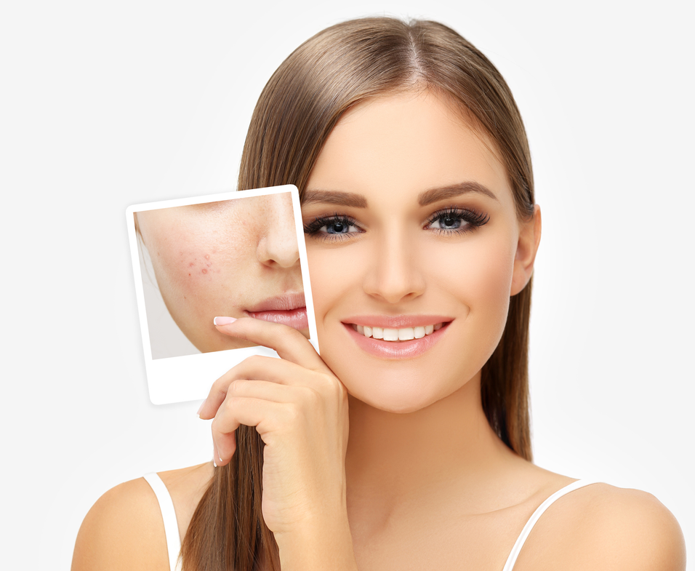
MILESTONE 2
Image Processing and Analysis: We used OpenCV to process images of skin diseases, which involves techniques such as image enhancement, noise reduction, and feature extraction. This step helps to improve the quality of the images and make the skin conditions more distinguishable for analysis.
Pattern Recognition and Feature Extraction: OpenCV tools were applied to identify specific patterns, textures, and features in the skin images, such as color, shape, and size of lesions. These patterns are crucial for recognizing different types of skin diseases, like melanoma, eczema, or psoriasis, and differentiating between them.
Supporting Diagnosis: By analyzing the processed images and identifying key features, OpenCV helped in the accurate diagnosis of various skin conditions. This automation aids healthcare professionals in making faster and more reliable diagnoses, improving the accuracy and efficiency of skin disease detection.

Slide 10
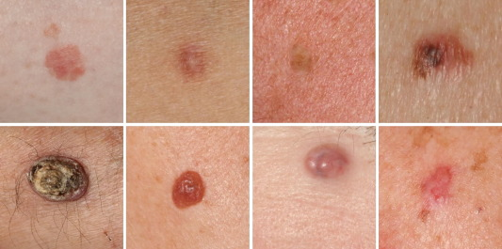
MILESTONE 3
User Interface (UI) for Image Input: We created a user interface that allows users to upload or select an image of a skin disease. This UI serves as an interactive element, enabling users to easily input images for processing without needing technical expertise.
Image Processing with OpenCV: After the image is uploaded, we utilized OpenCV to process the image and calculate the dimensions of the skin disease area. This involves using techniques like contour detection, thresholding, and segmentation to isolate the region of interest (skin lesion) and measure its area.
Displaying Results Back to the UI: Once the skin disease area is processed and its dimensions are calculated, the results (such as the area) are displayed back to the user on the UI. This provides a seamless and interactive experience, giving users immediate feedback on the analysis.

Slide 11
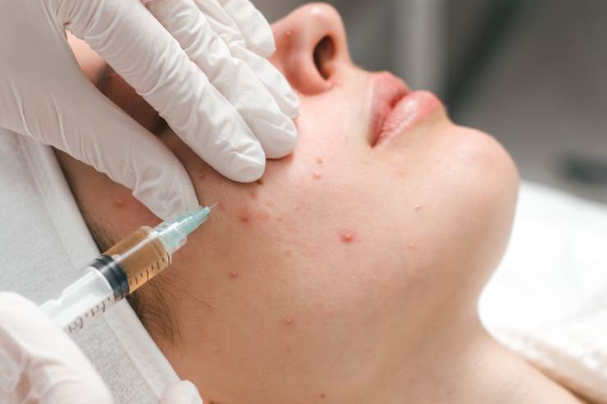
MILESTONE 4
Leveraging Pre-Trained Data for Disease Detection: Utilized pre-trained models to build a disease detection system. These models, which have been trained on large datasets, provide a strong foundation by recognizing patterns and features in images, reducing the need for training from scratch.
Model Evaluation and Selection: We analyzed several different models to determine the most effective one for the task. This process involved evaluating their performance on disease detection tasks and selecting the model that provided the best accuracy, efficiency, and generalization for detecting skin diseases.
Vision Transformer for Image Processing: After selecting Vision Transformer (ViT) we used it to process uploaded images. The Vision Transformer, with its self-attention mechanism, effectively captures the complex patterns in the images, allowing it to accurately identify and classify the skin disease detected in the uploaded images.

Slide 12
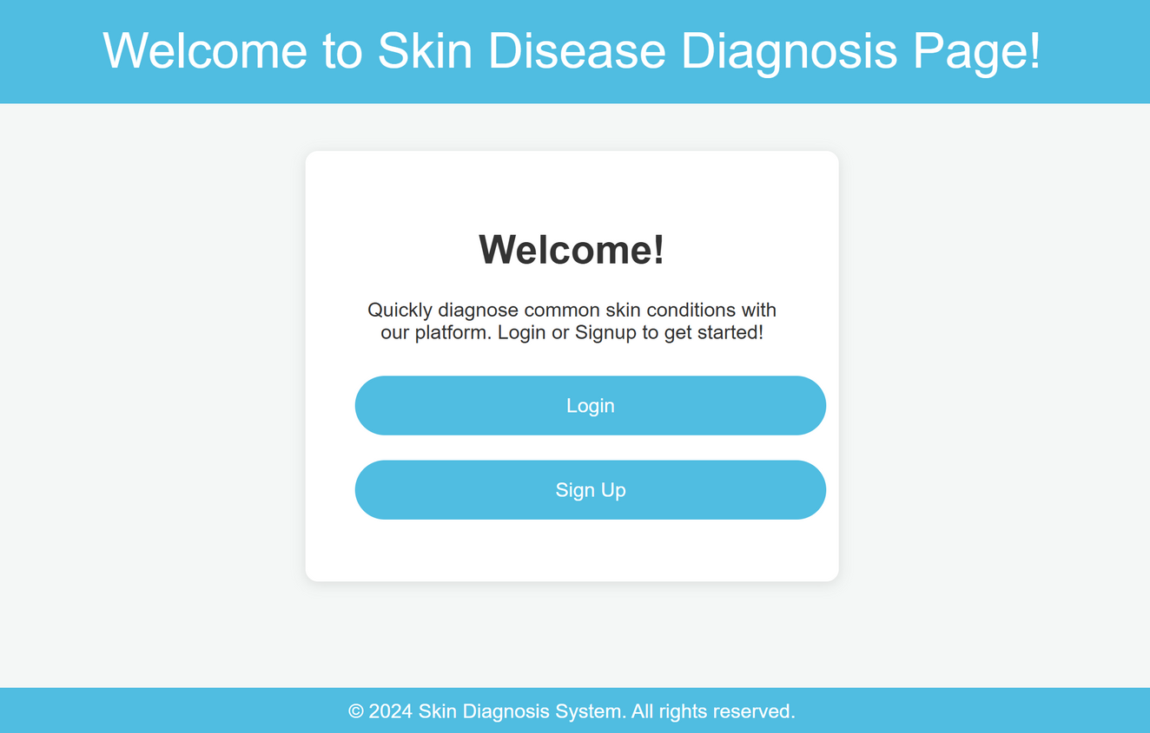
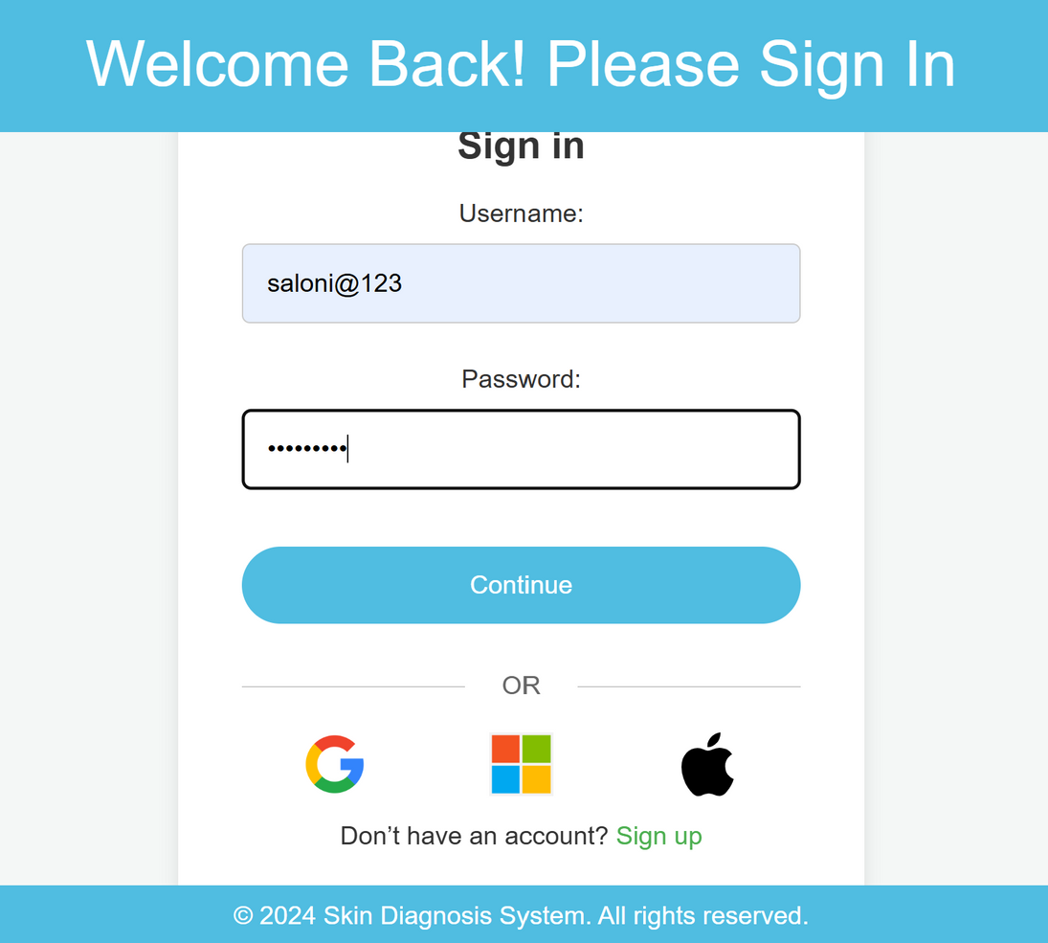


HOME PAGE/ LOGIN PAGE

Slide 13
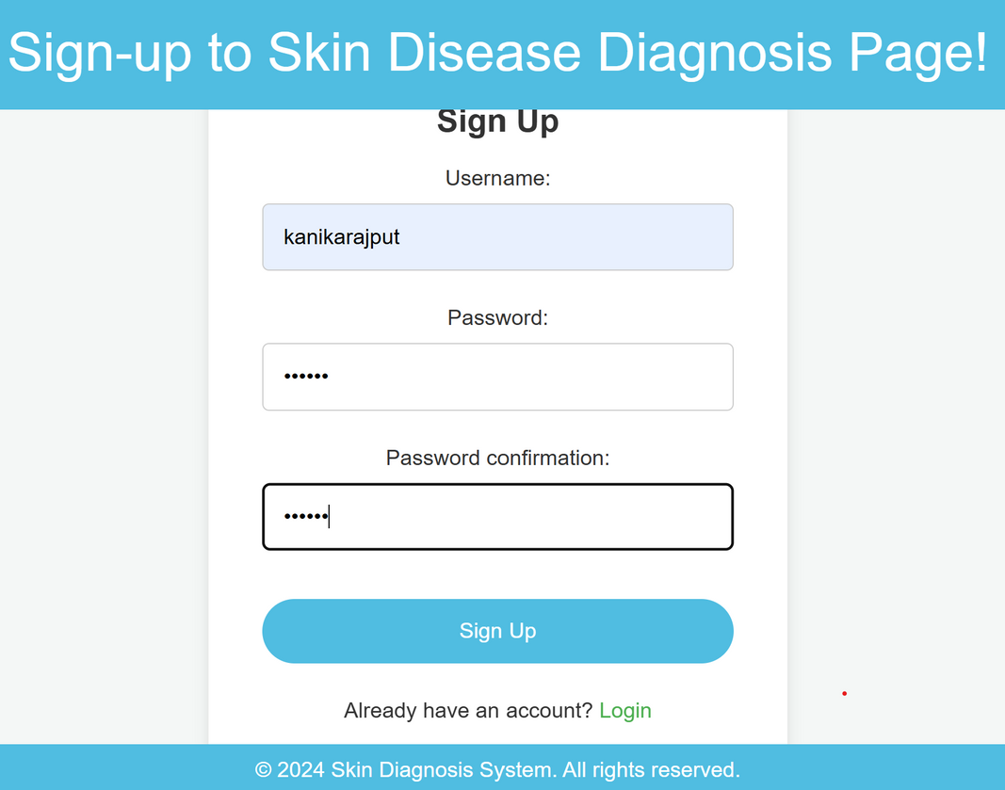
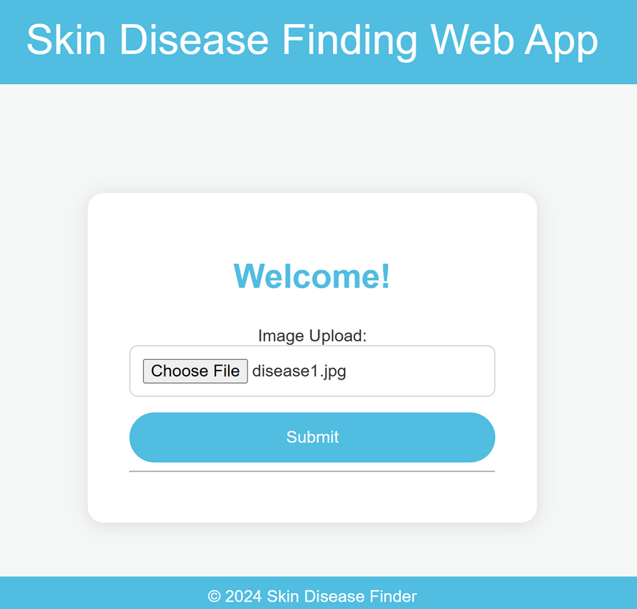

REGISTRATION PAGE / PROFILE PAGE
Avery Davis

Slide 14
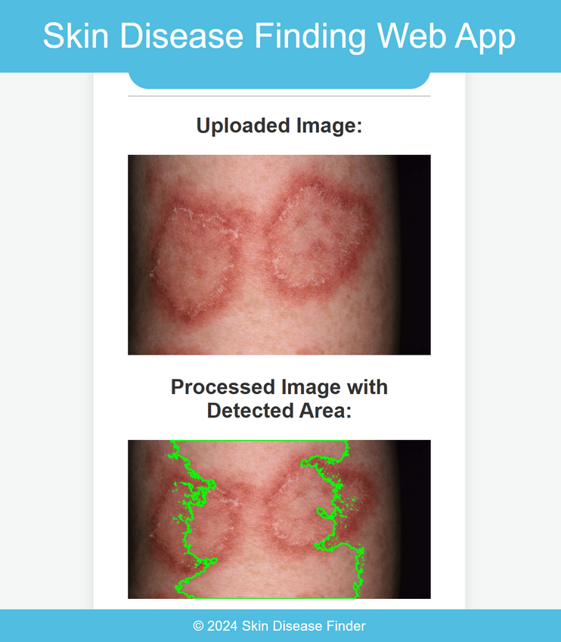
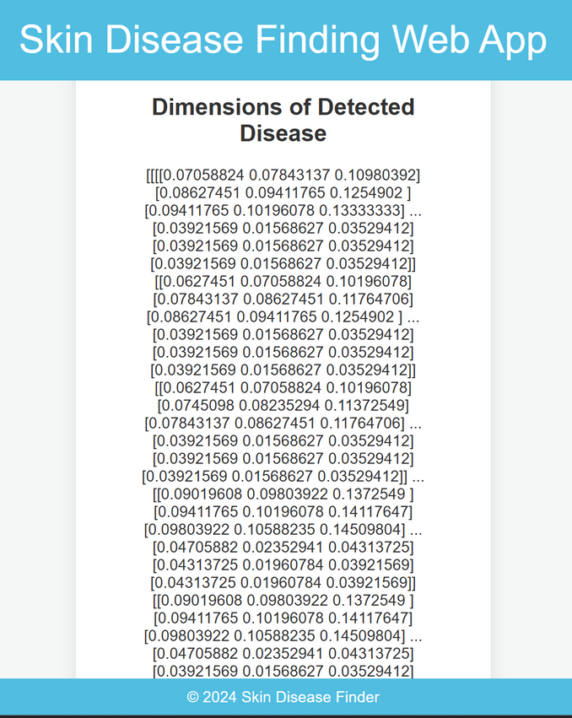
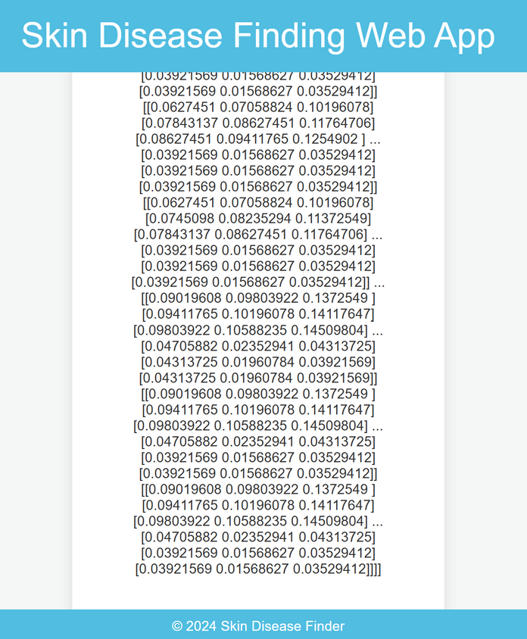
CALCULATED DIMENSIONS OF SKIN DISEASE

Slide 15
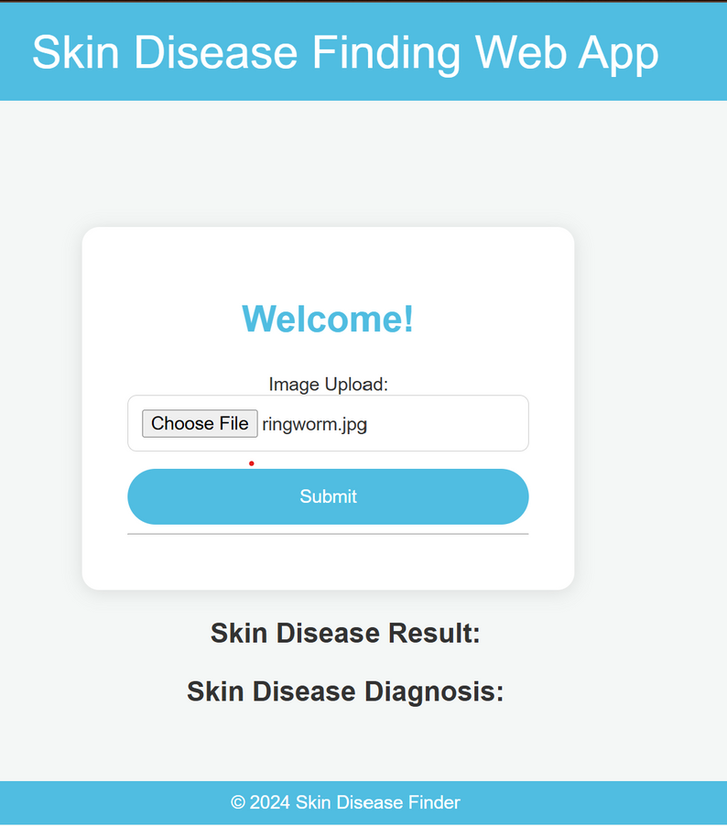
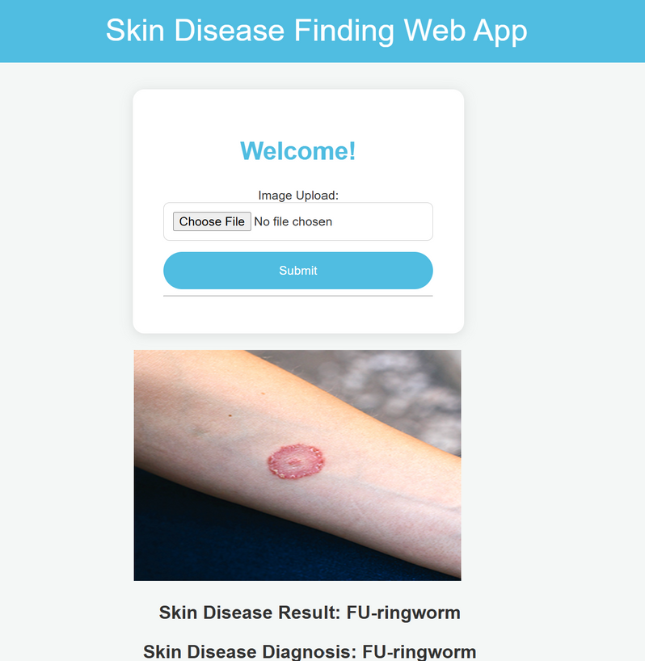
IMAGE UPLOAD / OUTPUT PAGE

Slide 16
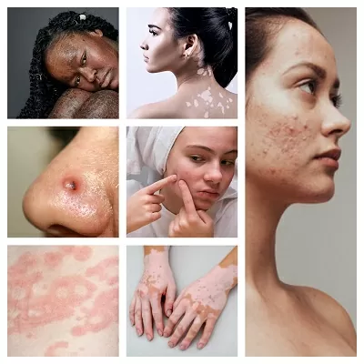
CONCLUSION
The "Advanced Skin Diagnosis leveraging image processing" system harnesses the power of OpenCV and Django (a python framework) to analyze and diagnose skin conditions from images. By accurately detecting key features and patterns in skin images, the system offers an efficient and reliable method for identifying various skin diseases. This innovative approach enhances early detection, enabling users to receive timely insights and recommendations for treatment.

Slide 17
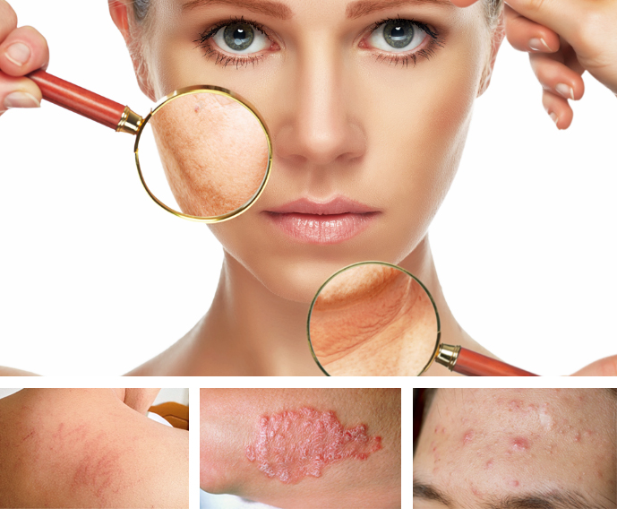
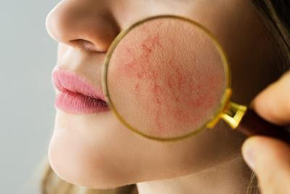
TEAM MEMBERS
Team 8:
Kanika Rajput
Sathi Lakshmi Narayana Reddy
Shaik Shariya

Slide 18
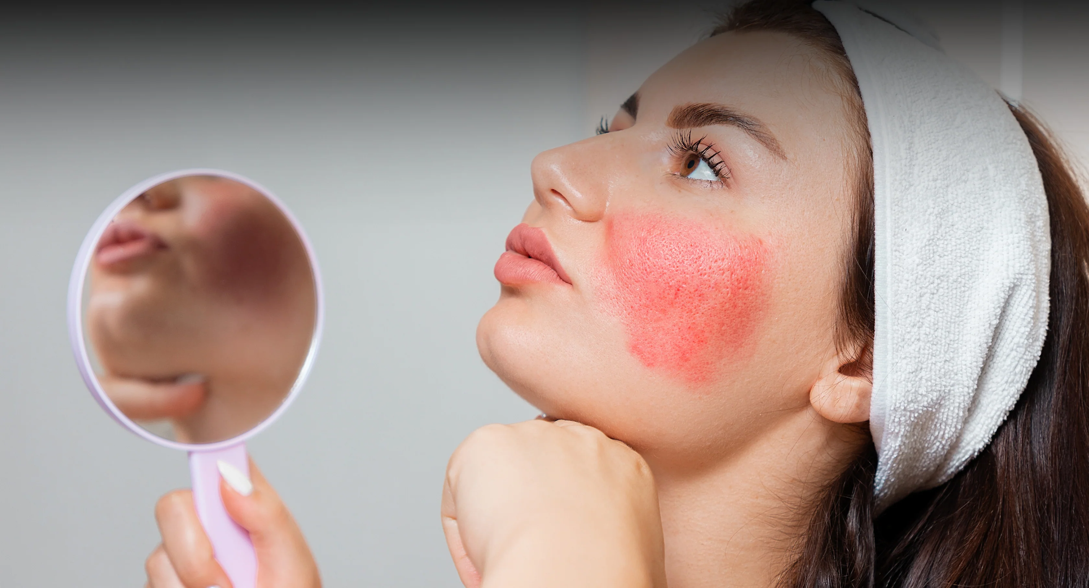
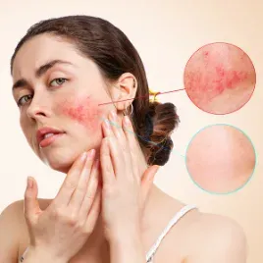
Thank
You

